Slide 1
Developments to established dose-finding methodologies for application in trials with complex and innovative designs

Slide 2
Aims
Investigate extensions to existing methodologies in early-phase trials
Introducing new concepts
Extending certain early-phase designs
Adapting current methodology
Implementing these extensions / other new methodology into trials

Slide 3
PO-TITE-CRM in ADePT-DDR
The ADePT-DDR trial is a platform trial for patients with HNSCC
The initial component of this trial is a single-arm dose-finding trial investigating AZD6738 in combination with radiotherapy.
PO-TITE-CRM (TITE-CRM for partial ordering)
Hasn’t been used before
Introduced in 2013 as an extension to the TITE-CRM
For use when the monotonicity assumption is violated

Slide 4
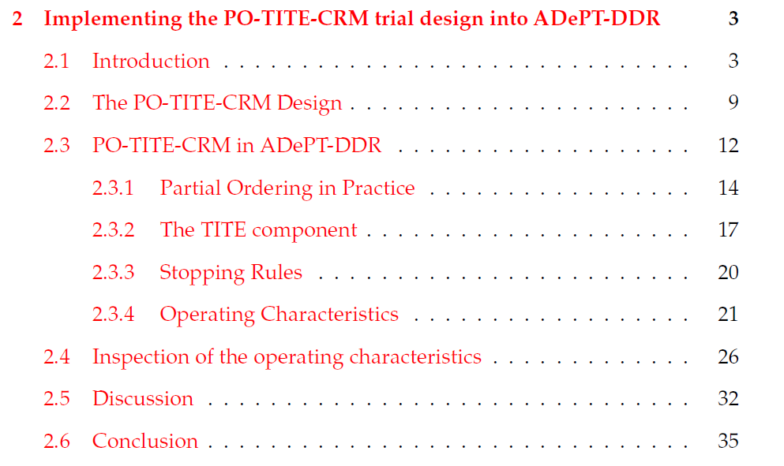

Slide 5
Future Chapter Ideas
Extension to the Wages and Tait design
Shannon entropy
TITE-DTPs
Modifying trial designs whilst its still open
Optimising model specification/dose escalation/sample sizes

